Slide 1
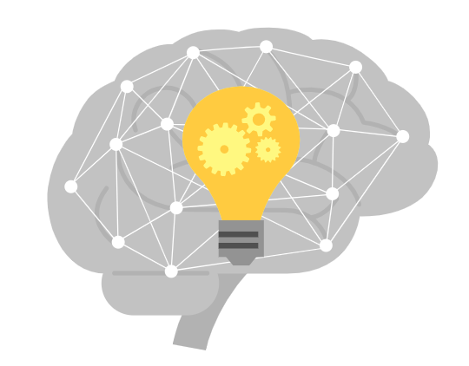
Machine Learning (For .NET developers)
Ankur Agarwal

Slide 2

What is Artificial Intelligence
Artificial Intelligence (AI) is a branch of computing that involves training computers to do things that normally require human intelligence.
Machine Learning -
Machine Learning (ML) is a subset of AI that involves computers learning from and finding patterns in data in order to then be able to make predictions on new data by themselves.

Slide 3
Introduction to Machine Learning
Machine Learning uses algorithm and statistical techniques to train the systems by themselves without using any explicit programs. Machine Learning is used to train the systems automatically by themselves and provide us the system predicted results.
In Machine Learning, 2 magical words are mostly used –
Training
Data

Slide 4



Training Process – Real life scenario

Slide 5
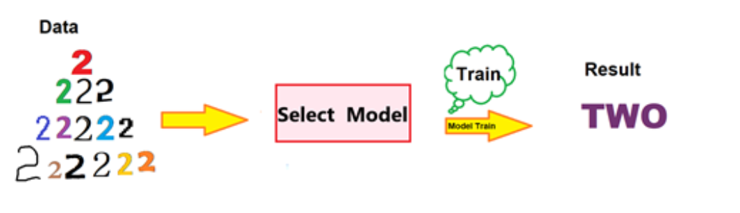
Machine Learning process
we can see the Machine learning process has been explained as first we give the data to the system and then we select the appropriate Machine Learning Model to train the system. After the training is completed, the machine is ready to predict the results and show the output to the outside world.

Slide 6
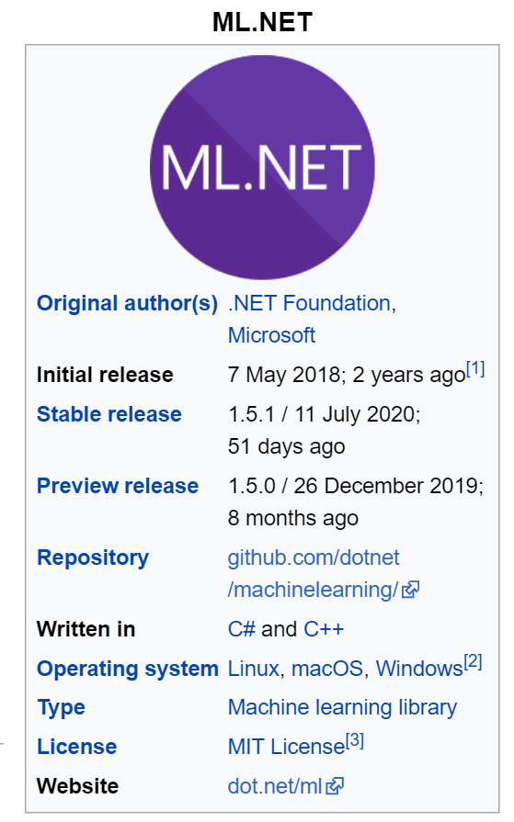
Introducing ML .NET
ML.NET is a free, open source, and cross platform machine learning framework for the .NET developer platform.
ML.NET allows you to train, build, and ship custom machine learning models using C# or F# for a variety of ML scenarios. ML.NET includes features like automated machine learning (AutoML) and tools like ML.NET CLI and ML.NET Model Builder, which make integrating machine learning into your applications even easier.

Slide 7
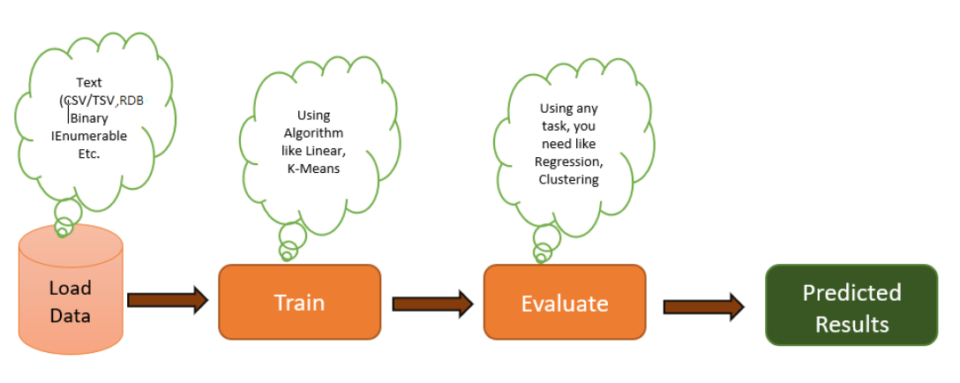
Stepping stones
Before getting started with the ML.NET, let's understand the basic concept of the ML.NET which needs to be used to develop our Machine learning applications.

Slide 8
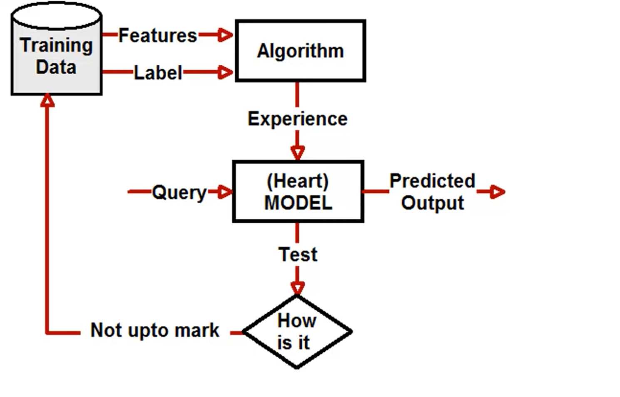
Machine Learning Technical Workflow

Slide 9
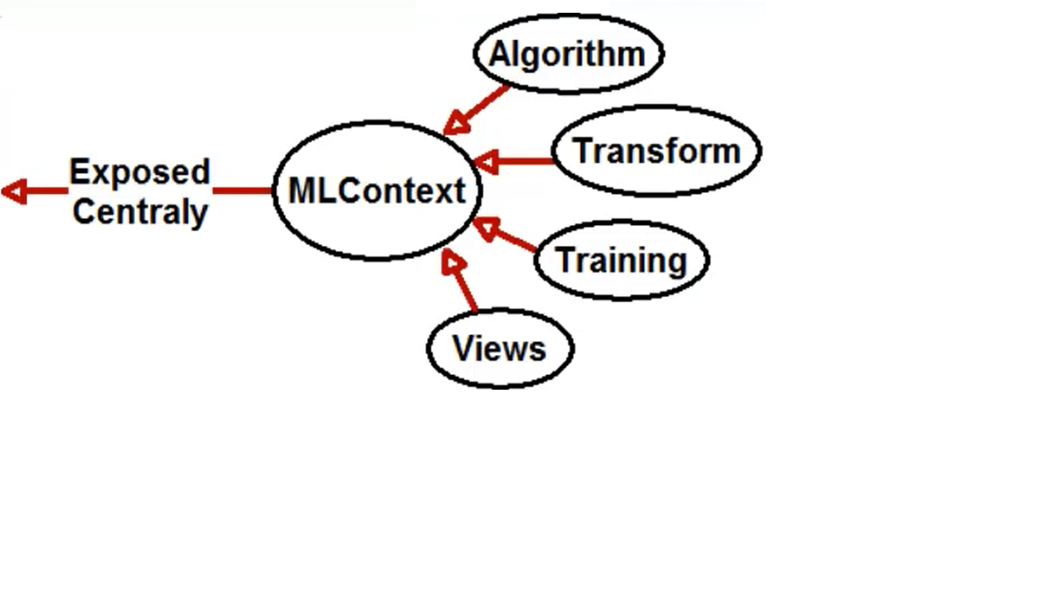
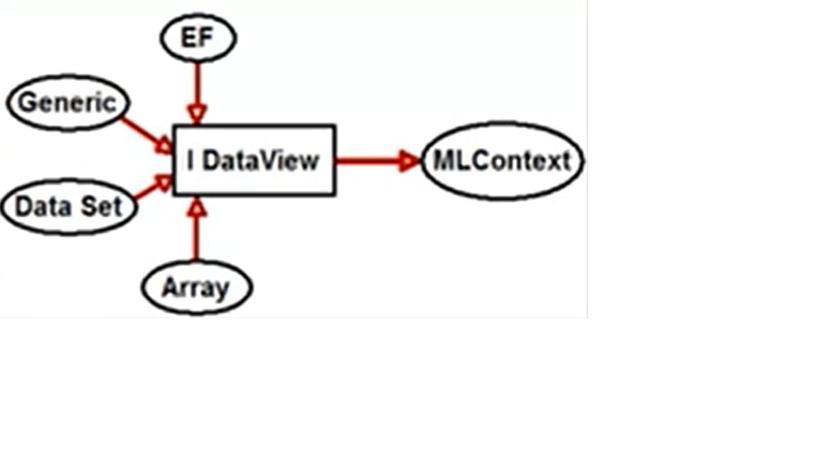
ML Context - All the responsibility of making an algorithm intelligent lies with ML Context. All operations like loading training data, transforming, applying right algo are responsibility of ML Context.
Data View –
Object which Loads training data from Database/ Text file/ In memory or any other source and connect that data with ML Context.

Slide 10
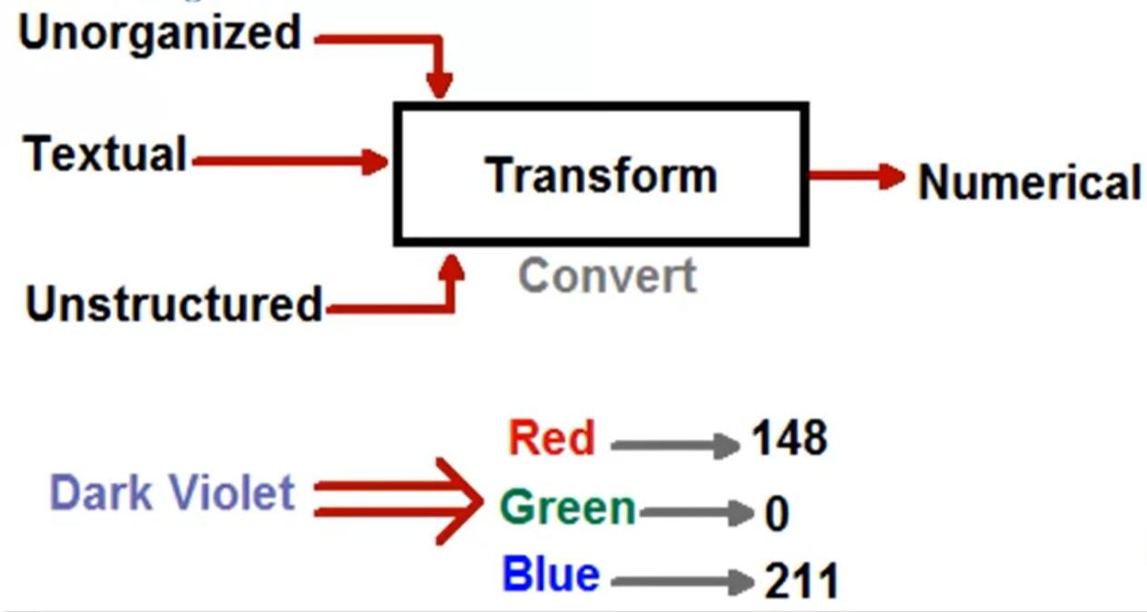
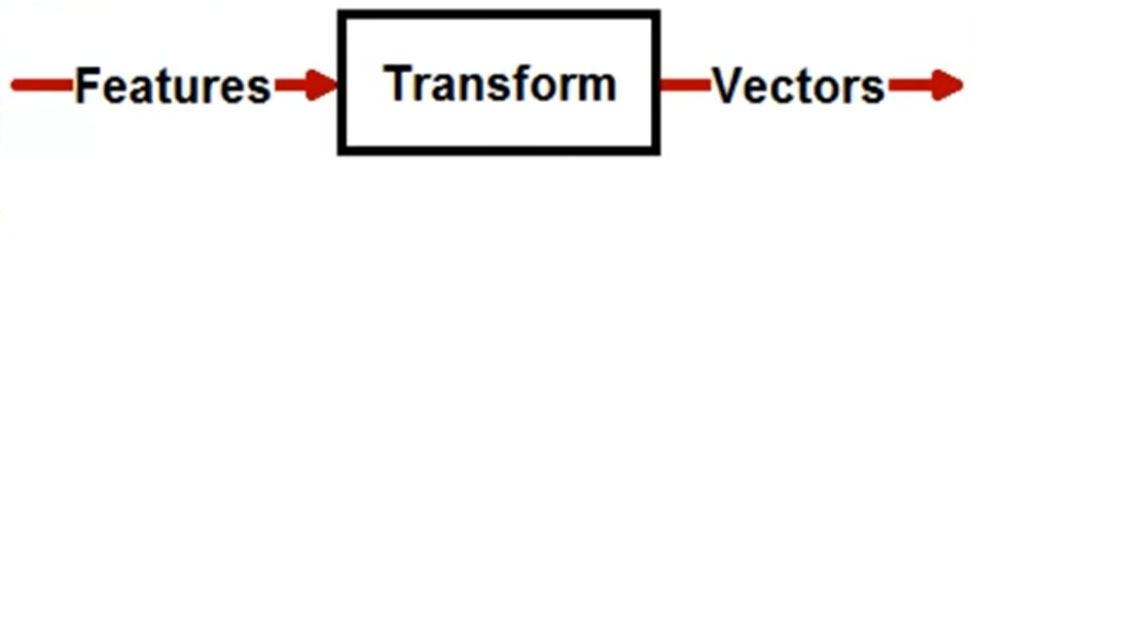
Transform - Converting unstructured/ Textual or unorganized data into structured format. In Machine language terms this is called converting to Numerical.

Slide 11
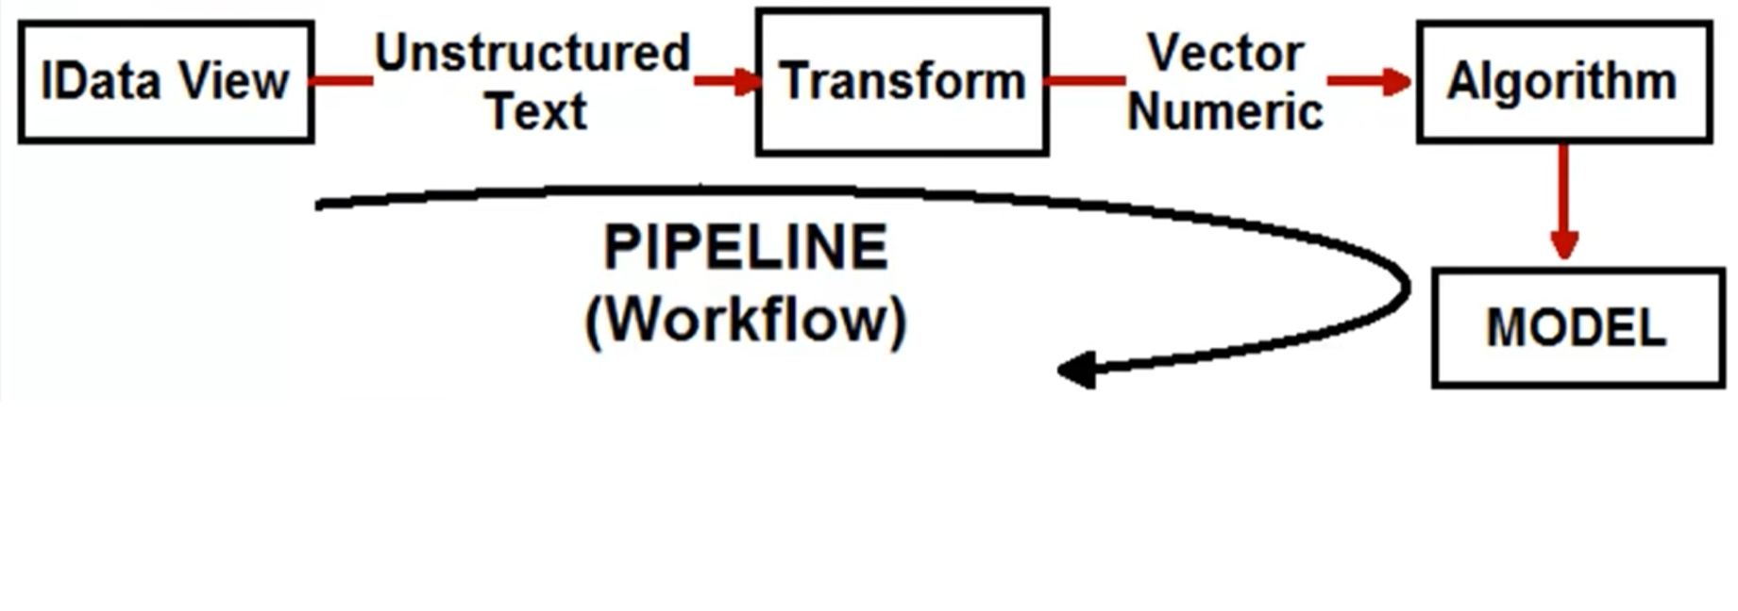
Pipeline-
Pipeline is logical workflow to load training data, transform it and pass it to an algorithm like Linear regression, Binary classification, K-Mean etc. Finally it creates a model, which can be shipped to prod to finally predict output.

Slide 12
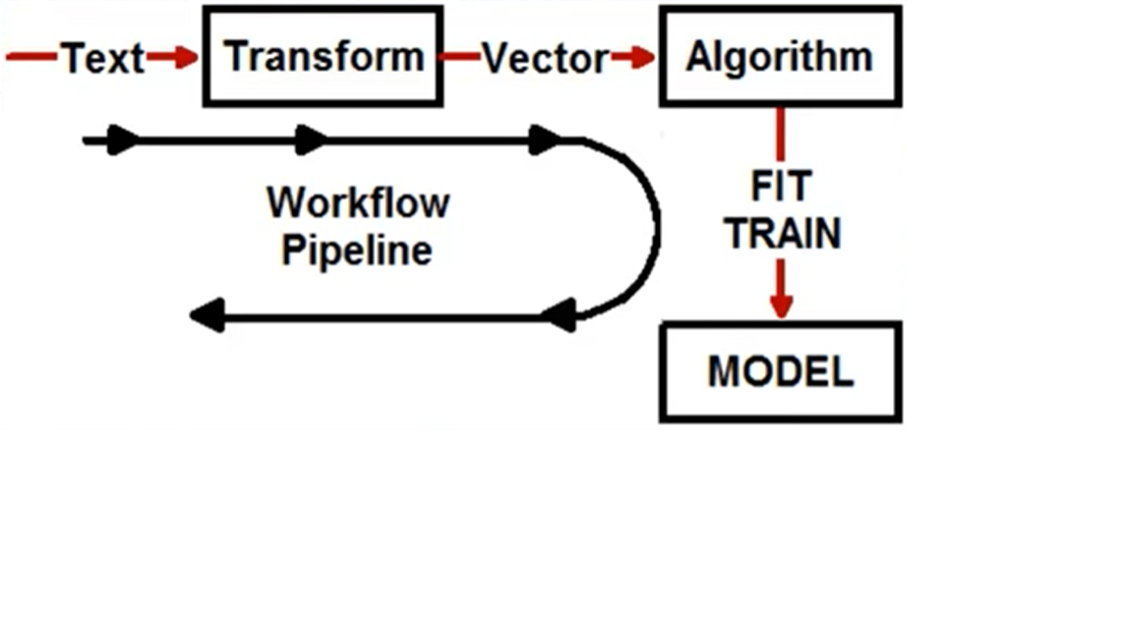
Pipeline-
Fit is actually creating the trained model.

Slide 13


Slide 14

Thank you

